Slide 1
Principles of Data Science
Li Niu

Slide 2



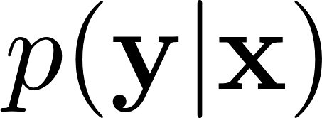


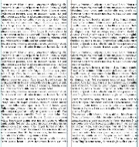
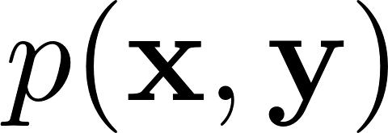
: feature
: target information
Sample 1
image
video
text
Discriminative model:
Sample 2
…
Generative model:
Sample n
Data
Feature
Information

Slide 3
: feature
Sample 1
image
video
text
How to extract features?
data preprocessing
feature engineering
feature encoding
Sample 2
…
Sample n
Data
Feature

Slide 4

: feature
correlation
dimension reduction
distance
kernel trick
…
Feature

Slide 5
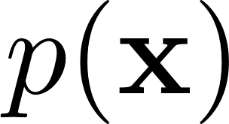
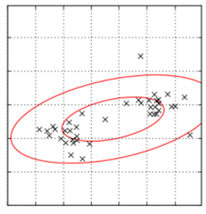
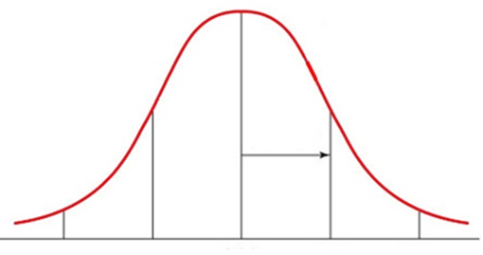


: feature
samples
data distribution
principle component
…
Feature

Slide 6
: feature
: target information
Sample 1
Sample 2
Discriminative model:
…
Generative model:
Sample n
Feature
classification
Information

Slide 7
Mismatch between training set and test set
Data distribution mismatch
(domain adaptation/generalization)
Feature type mismatch
(multi-view learning, privileged information)
Category mismatch
(zero-shot learning)
Training set
Test set

Slide 8
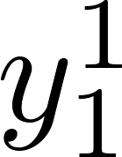
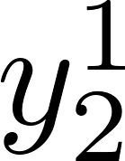
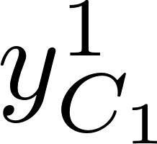

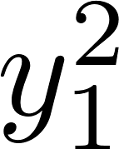
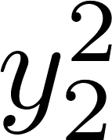
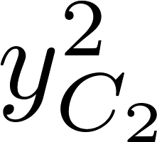
Beyond single-label single-task
label 1
label 2
task1
…
…
label C1
label 1
label 2
…
task2
…
label C2

Slide 9
Thanks!

